Slide 1

Chapter 15
People Defining Development
Notes:
For a better classroom presentation flow, the order of some topics in this lecture outline differs slightly from the order of topics in the text and, where this occurs, some figures and tables are out of numerical order.

Slide 2
Learning Objectives
15.1 Identify what is development and approaches to it.
15.2 Summarize how indigenous peoples and women are redefining development.
15.3 Identify urgent issues in development.

Slide 3
Defining Development and Approaches to It (1 of 2)
15.1 Identify what is development and approaches to it.
Two Processes of Social Change
Theories and Models of Development
Institutional Approaches to Development
The Development Project

Slide 4
Defining Development and Approaches to It (2 of 2)
Development
  Change directed toward improving human welfare
Poverty
  Lack of access to tangible or intangible resources that contribute to life and the well-being of a person, group, country, or region

Slide 5
Two Processes of Social Change
Invention
  The discovery of something new
    May be sudden or gradual
Diffusion
  The spread of culture through contact
    May be mutual borrowing
    May be through force between unequal societies

Slide 6
Anthropology Works: The Saami, Snowmobiles, and Social Impact Analysis (1 of 2)
Social impact assessments gauge the potential social costs and benefits of particular innovations before change is undertaken
Prior to the 1960s, a Saami group in Finland had an economy based on reindeer herding
  Provided most of their diet
  Used as draft animals
  Used for clothing
  Key items of exchange

Slide 7
Anthropology Works: The Saami, Snowmobiles, and Social Impact Analysis (2 of 2)
Introduction of snowmobiles for herding in the 1960s changed the culture
  Herds were no longer domesticated
  Herders covered larger areas
  Used multiple roundups
  Young men became dominant herders (squeezing out women and older men)
  Herds declined as a result of the stress associated with the snowmobiles
  New dependence on outside cash economy drove many to migrate to cities for work

Slide 8
Theories and Models of Development (1 of 5)
Modernization
  A form of change marked by economic growth through industrialization and market expansion, political consolidation through the state, technological innovation, literacy, and options for social mobility
  Major goals
    Material progress and individual betterment
  Major criticisms
    Focus on ever-increasing consumption
    Heavy use of nonrenewable resources

Slide 9
Theories and Models of Development (2 of 5)
Growth-Oriented Development
  Development as “induced” change by applying modernization theory in so-called developing countries
  Promoting economic growth includes two strategies
    Increasing economic productivity and trade through modernized agriculture and manufacturing and participation in world markets
    Reducing government expenditures on public services to reduce debt and reallocate resources to increase productivity

Slide 10
Theories and Models of Development (3 of 5)
Distributional Development
  Emphasis on social equity in benefits, especially in terms of increased income, literacy, and health
  Based on evidence that growth-oriented strategies, applied without concern for distribution, increase social inequality
  Needs benevolent governments to ensure equitable access to crucial resources to enhance the ability of the poor to provide for their own needs

Slide 11
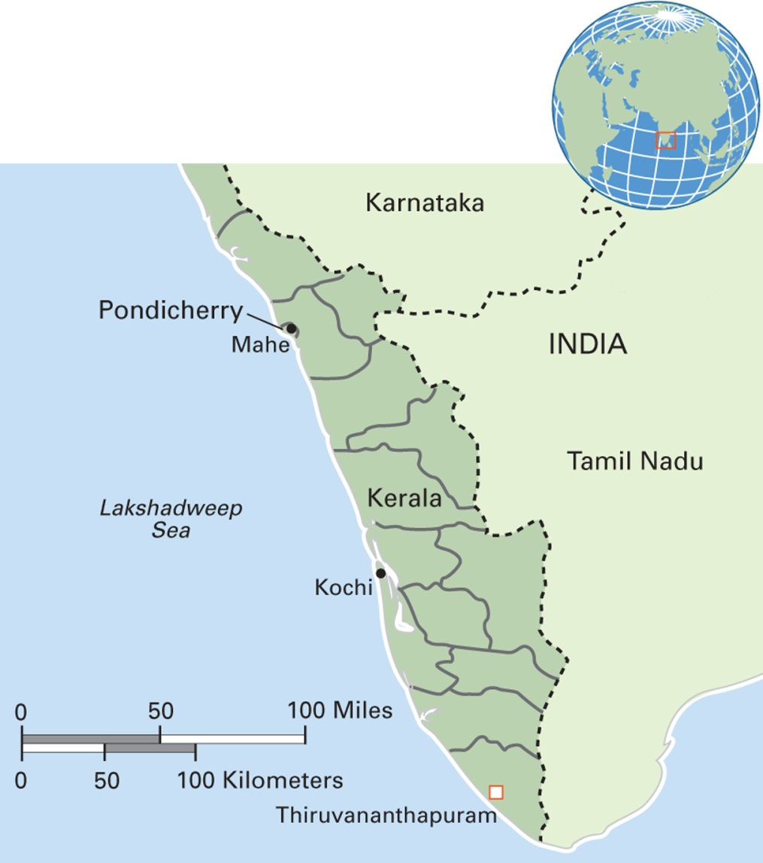
Map 15.2 Kerala, South India
Notes:
With a population of 34 million, Kerala has living standards, literacy rates, and health indicators that are high compared with the rest of India. Kerala comprises 14 districts and three historical regions: Travancore in the south, Kochi in the central part, and Malabar in the north. Long a socialist democracy, Kerala now allows the free market and foreign direct investment to play larger roles. A major tourist destination because of its tropical ecology and cultural features such as dramatic martial arts and theater, Kerala also hosts a growing Ayurvedic health tourism industry along its coast.

Slide 12
Theories and Models of Development (4 of 5)
Human Development
  Emphasizes investing in human welfare, which will lead to economic development
  Economic resources combined with distributive policies

Slide 13
Theories and Models of Development (5 of 5)
Sustainable Development
  Forms of improvement that do not destroy nonrenewable resources
  Financially supportable over time
  The economic growth of wealthy countries has been costly in terms of the natural environment and people whose lives depend on fragile ecosystems
  Today, increased concern globally about the environment is generating new ideas about energy generation

Slide 14
Institutional Approaches to Development (1 of 2)
Large-Scale Development Institutions
  Multilateral (multiple donor countries)
    United Nations
      UNDP, FAO, WHO, UNICEF, UNESCO, UNHCR
    World Bank
      IBRD loans with interest to credit-worthy governments
      IDA interest-free loans to poorest countries
  Bilateral (one donor country)
    USAID, JICA, CIDA, DfID . . .

Slide 15
Institutional Approaches to Development (2 of 2)
Grassroots Approaches
  Locally initiated small-scale projects
  Social capital
    The intangible resources existing in social ties, trust, and cooperation
  Religious organizations sponsor a variety of grassroots projects
    Example: BEC in the Philippines

Slide 16
Culturama: Peyizan Yo of Haiti (1 of 2)
Haiti
  Became first independent state in Latin America in 1804 after a revolt against France, and the first to abolish slavery in the Western Hemisphere
  Legacy of colonialism has degraded environment and the economy
Peyizan Yo
  Small farmers in Haiti who produce for their own use and for the market
  Active social organizations promote economic security

Slide 17
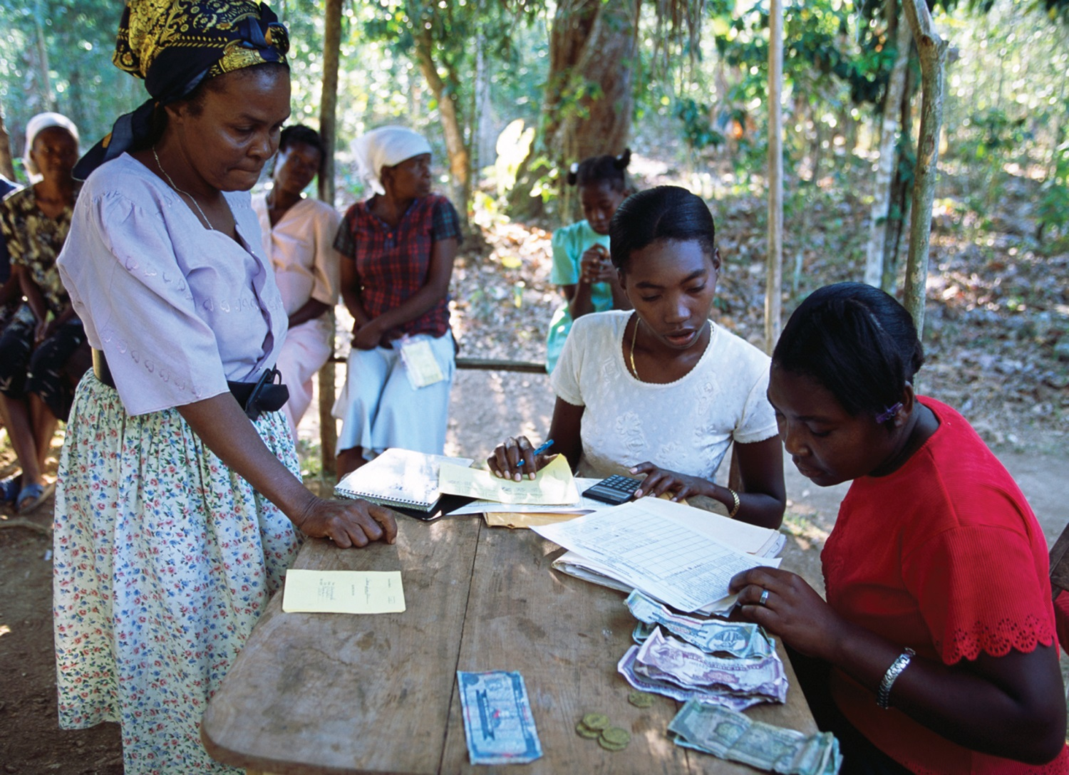
Culturama: Peyizan Yo of Haiti (2 of 2)
Notes:
A woman repays her loan at a small-scale savings and loan business in rural Haiti. Many of the credit union members use their loans to set up small businesses.

Slide 18
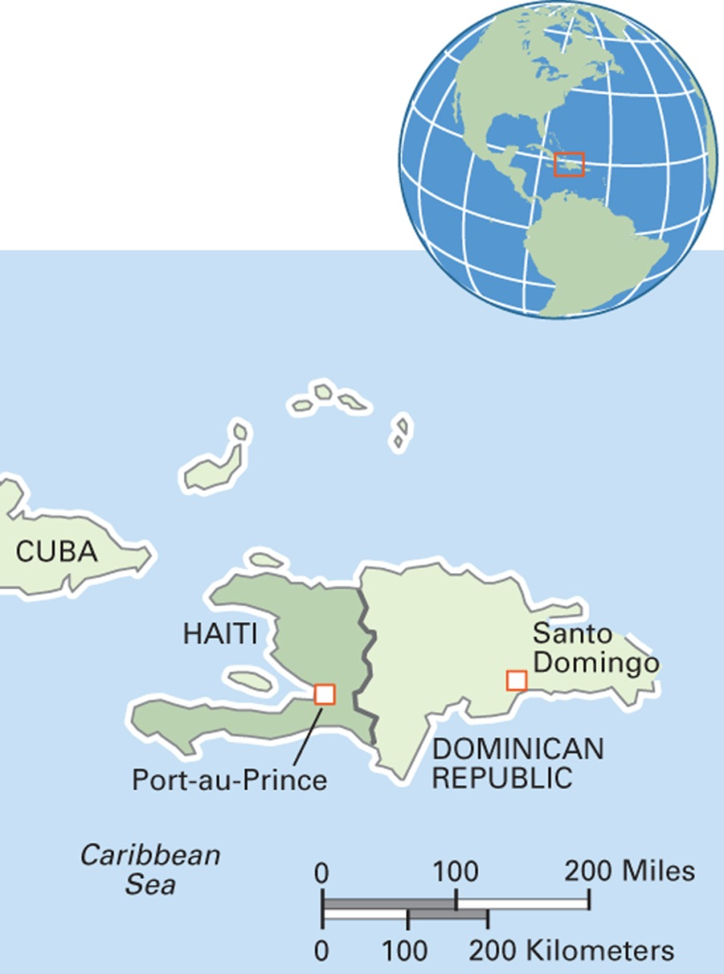
Map 15.3 Haiti
Notes:
The Republic of Haiti occupies one-third of the Caribbean island of Hispaniola. The population of Haiti is around 10 million.

Slide 19
The Development Project (1 of 4)
Development project
  A set of activities designed to put development policies into action
  Development project cycle
    Project identification
    Project design
    Project appraisal
    Project implementation
    Project evaluation

Slide 20
The Development Project (2 of 4)
Anthropologists and development projects
  When hired only to evaluate projects, they found failure was common because:
    Project did not fit context
    Benefits did not reach target group
    The intended beneficiaries were worse off than before

Slide 21
The Development Project (3 of 4)
Cultural Fit
  A characteristic of informed and effective project design in which planners take local culture into account
    Example of failure: nutrition program in the South Pacific delivered powdered milk to the lactose intolerant
    Example of success: short-term reforestation in Haiti

Slide 22
The Development Project (4 of 4)
The Anthropological Critique of Development Projects
  Traditional development anthropology
    The anthropologist accepts the role of helping to make development work better by providing cultural information to planners
  Critical development anthropology
    The anthropologist asks why and to whose benefit particular policies and programs are pursued

Slide 23
Development, Indigenous People, and Women
15.2 Summarize how indigenous peoples and women are redefining development.
Indigenous People and Development
Women and Development

Slide 24
Indigenous People and Development (1 of 4)
Indigenous populations increasingly under threat from extractive industries, political repression, tourism
Accurate numbers of indigenous people difficult to obtain; roughly 400 million (5 percent of global population)

Slide 25
Indigenous People and Development (2 of 4)
Indigenous People as Victims of Colonialism and Development
  Indigenous people have been subjected to loss of rights, land, and culture they once had
    Historically
      The result of colonial takeovers
    In contemporary times
      Example: “planned resettlement” of “hill tribes” in Southeast Asia

Slide 26
Indigenous People and Development (3 of 4)
Indigenous People and Territorial Entitlements
  Mixed results across geographic regions
  Two examples of success
    Nunavut Territory, Canada
    Torres Strait Islands, Australia

Slide 27
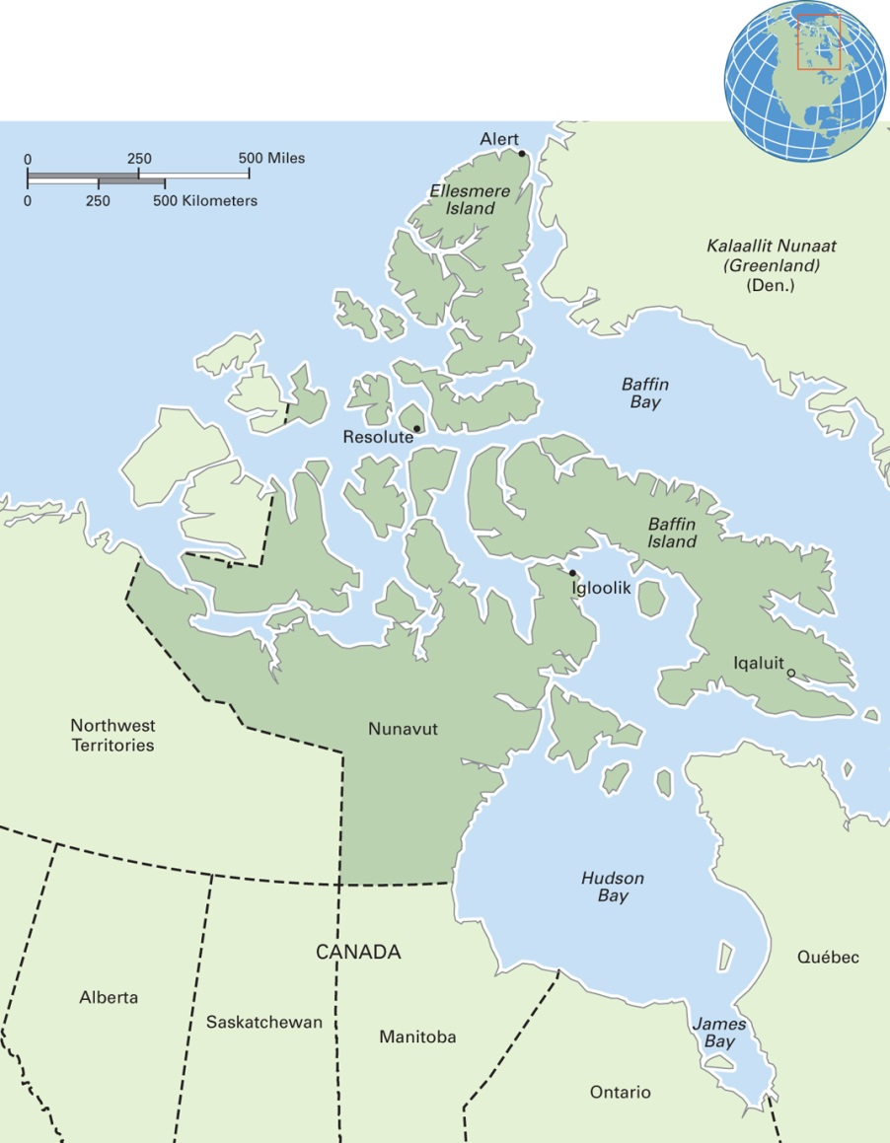
Map 15.5 Nunavut Territory, Canada
Notes:
Created in 1999, Nunavut is the newest and largest of Canada’s territories. It is also the least populated, with 34,000 people. About 85 percent of the people are First Nations peoples, mainly Inuit. Official languages are Inuktitut, Inuinnagtun, English, and French. The landscape is mainly Arctic tundra. The award winning movie Atanarjuat (The Fast Runner) was produced by Inuit filmmakers and filmed in Nunavut.

Slide 28
Indigenous People and Development (4 of 4)
Organizing for Change
  Indigenous peoples have formed grassroots organizations “development from within”
  Example: Hundee of Ethiopia
    Includes elements of Western development combined with Oromo values and traditional laws

Slide 29
Women and Development (1 of 2)
Male Bias in Development
  The design and implementation of development projects with men as beneficiaries and without regard to the impact of the projects on women’s roles and status
  Project planners tend to regard men as the farmers and users of technology
  Projects targeted at women often focus on the domestic domain: child care, family planning

Slide 30
Women and Development (2 of 2)
Women’s Organizations for Change
  Women’s advocacy organizations include groups:
    Based on traditional culture
      Example: SMW in Kazakhstan
    Inspired by outside models
    Small-scale and local
    Global
      Example: Women’s World Banking
    Based on informal support networks
      Example: Maya vendors in Chiapas, Mexico

Slide 31
Urgent Issues in Development (1 of 2)
15.3 Identify urgent issues in development.
Life Projects and Human Rights
Cultural Heritage, Human Rights, and Development: Linking the Past and Present to the Future

Slide 32
Urgent Issues in Development (2 of 2)
Development aggression
  The imposition of development projects and policies without the free, prior, and informed consent of the affected people

Slide 33
Life Projects and Human Rights
Moving away from “development projects” designed by outsiders
Moving to projects defined by insiders: their vision for the direction they want to take in life, informed by their knowledge, history, and context, and how to achieve that vision
Against extractive development

Slide 34
Eye on the Environment: Oil, Environmental Degradation, and Human Rights in the Niger Delta (1 of 3)
Since the 1950s and the discovery of vast petroleum reserves, Nigeria is a major oil producer
Industry caused significant environmental damage, destroying agricultural and fishing livelihoods
Ken Saro-Wiwa, an author and Nobel prizewinner, was a vocal opponent of oil development in Ogoniland

Slide 35
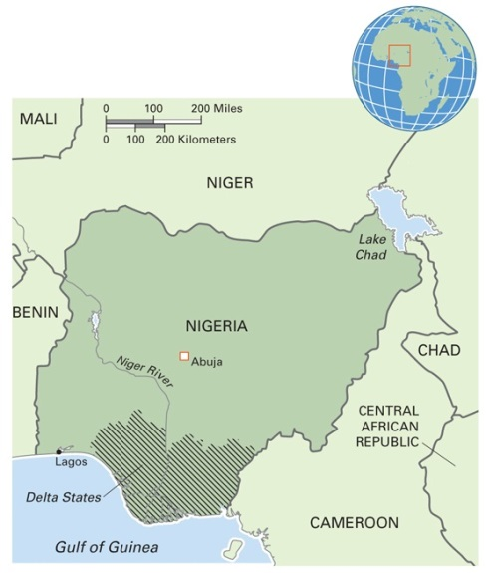
Map 15.7 Nigeria and the Niger Delta
Notes:
Nigeria is the most populous country in Africa, with over 140 million people. It has more than 250 ethnic groups, with the largest being the Fulani, Hausa, Yorúbà, and Igbo. Nigerians speak over 500 languages; English is the official language. Nigeria is Africa’s biggest petroleum producer, with an average of two million barrels a day extracted in the Niger Delta. The delta makes up 7.5 percent of Nigeria’s landmass, but its population of 31 million accounts for 22 percent of the population. The Niger Delta’s petroleum industry supports a high economic growth rate for the country, making it one of the fastest growing economies in the world. Yet little of this wealth filters back to the local people of the delta, who bear the brunt of the environmental and cultural damage caused by the petroleum industry. Oil spills are a frequent problem. One of the world’s richest wetlands and richest areas of cultural diversity, with over 40 ethnic groups, is endangered by large-scale petroleum mining that benefits people in the capital city and in other countries.

Slide 36
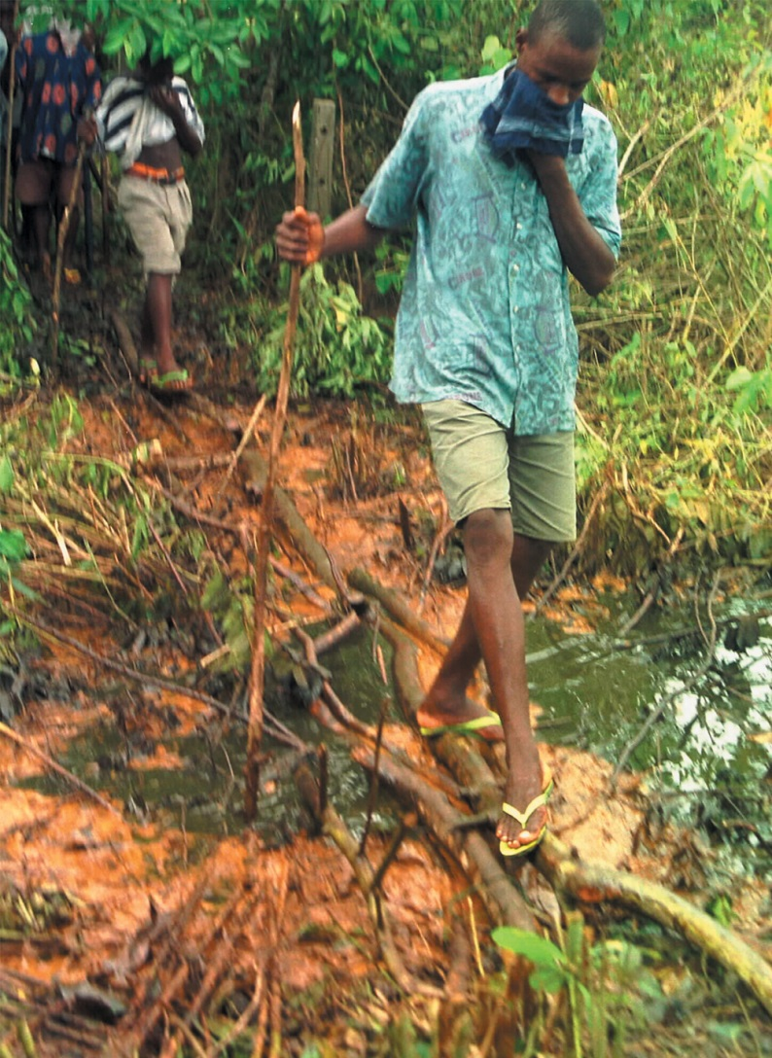
Eye on the Environment: Oil, Environmental Degradation, and Human Rights in the Niger Delta (2 of 3)
Notes:
A farmer walks through an oil-soaked field. About 500,000 Ogoni people live in Ogoniland, a deltaic region in southern Nigeria. The fertility of the Niger delta has supported farming and fishing populations at high density for many years. Since Shell discovered oil there in 1958, 100 oil wells were constructed in Ogoniland and countless oil spills have occurred.

Slide 37
Eye on the Environment: Oil, Environmental Degradation, and Human Rights in the Nigerian Delta (3 of 3)
Saro-Wiwa was arrested, tried, and executed under suspicious circumstances in 1995
He maintained that oil exploration violated human and cultural rights because it undermined his people’s way of life and threatened their continued existence

Slide 38
Cultural Heritage, Human Rights, and Development: Linking the Past and Present to the Future (1 of 2)
Cultural heritage tourism as double-edged sword
  Tourism brings income
  Requires infrastructure development
  Numerous visitors may damage site
    Example: Angkor Wat

Slide 39
Cultural Heritage, Human Rights, and Development: Linking the Past and Present to the Future (2 of 2)
Cultural Property Rights Law
  Developing field as lawyers and lawmakers define rights and protections for cultural heritage
  Another double-edged sword
    May secure rights and proceeds for threatened aspects of culture
    However, the process of legalization and related requirements may transform everyday life into legal battles

